Slide 1
C.V.O. CHARTERED & COST ACCOUNTANTS’ ASSOCIATION
CA CAREER GUIDANCE PROGRAMME
An initiative by
19th June, 2022

Slide 2
I don’t know what to do after X - XII. May be, B.com is a good option
CA is very difficult to pass. I am not made for CA
My friend is doing CA, should I also join CA?
My Parents are forcing me to do CA.

Slide 3
DREAM CA, BELIEVE CA, ACHIEVE CA
Economic well-
being
Reputation
International exposure
Good social stature
Attractive career options
Dedicated professional
CA student

Slide 4
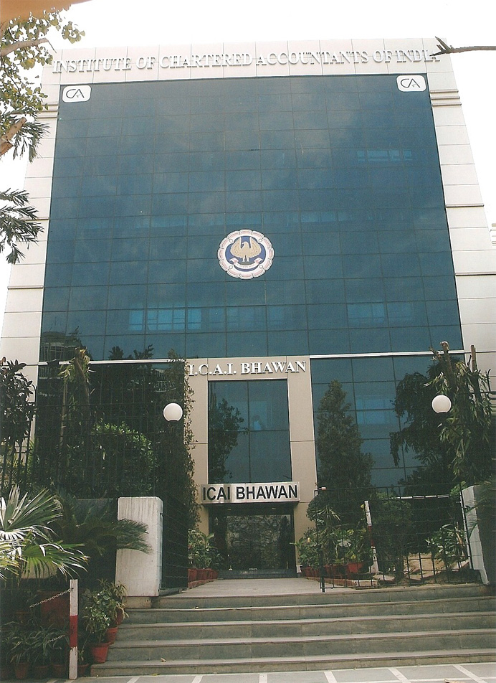
ICAI
A statutory body established by an Act of Indian Parliament “The Chartered Accountants Act, 1949”
ICAI conducts Education, Regulatory and Disciplinary Function
Distant Mode of Education. Education through Accredited Institutions, Branches, e-lectures, video lectures and web casts
Comply with the requirements of international educational pronouncements of IFAC
Comprehensive and contemporary theoretical and practical curriculum
One of the largest accounting examination networks
Exams are held twice a year
Examination system considered to be of high standard & integrity worldwide
ICAI is the 2nd largest Accounting Body in the World

Slide 5
USP OF CA PROFESSION
Open for all Streams:
Commerce/ Science/ Arts
Offers opportunities for Distance Learning
No reservations.
Only Merit
Standardised Course with regular updates
Catalyst in Economic Policies of Government
Age is no Bar:
Anyone can register in CA
Elements of theory & practice in 3 years of articleship
Regulator of Audit and Assurance functions
Great Learning at minimal cost
Cloud Campus for Students

Slide 6
FUTURE OF CA PROFESSIONAL

Slide 7
OPPORTUNITIES IN FUTURE
Practice
EMPLOYMENT/ INDUSTRY
P
E
ENTREPRENEURSHIP BUSINESS
E
FURTHER STUDIES
S

Slide 8
CA CAN SERVE IN ALL FIELDS OF COMMERCE
Commerce
Management Consultancy services
Entrepreneur
Information Technology consulting
Business
Advisory services
CHARTERED ACCOUNTANT
Government
Advanced finance and economics
Academics

Slide 9
ADDITIONAL ADVANTAGES
Eligible for appearing in Civil Services Examinations
Tie up with “IIM” on certain Management Courses
Eligible for Ph.D in certain Indian Universities & IITs
Certificate Courses/Post Qualification Courses

Slide 10
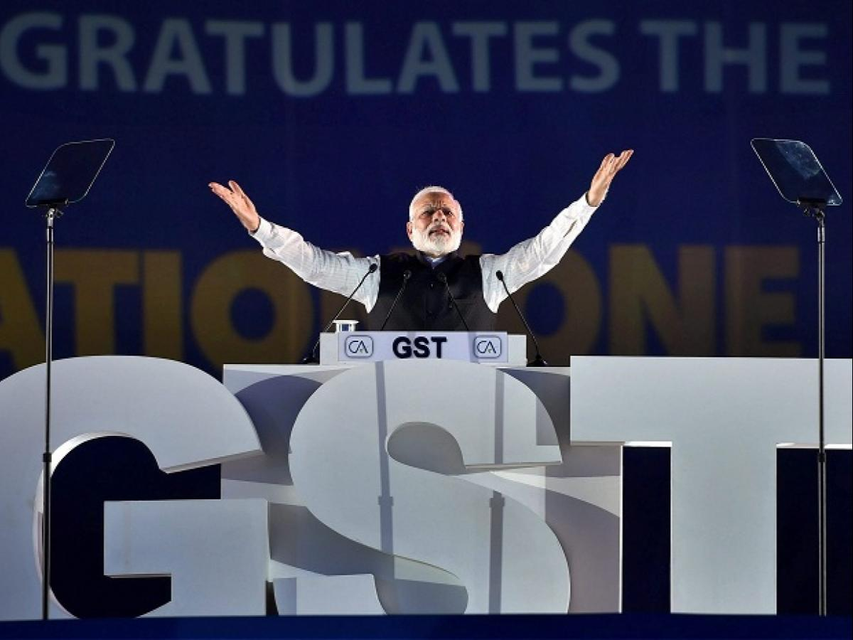
POWER OF CA’s SIGNATURE
The signature of CA is more important than the signature of Prime Minister
Statutory Audit
Tax Audit
Forensic Audit
Foreign Currency Remittances
Various other ‘Assurance Services’ under various Statutes
These are the areas in which it is mandatory to get documents certified by a Chartered Accountant

Slide 11
WHO SHOULD DO CA?

Slide 12
Hardworking
Dedication
Time Management
Analytical skills
Romancing with Numbers
Memory

Slide 13
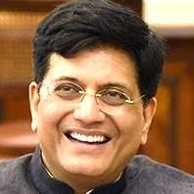
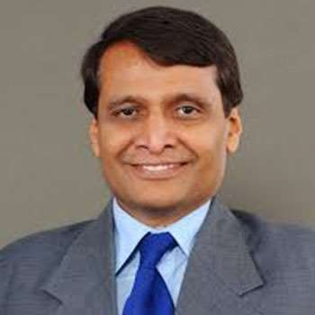
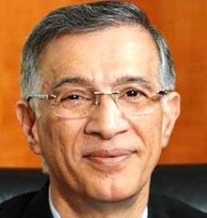
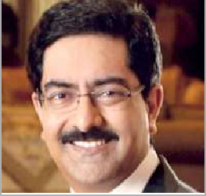
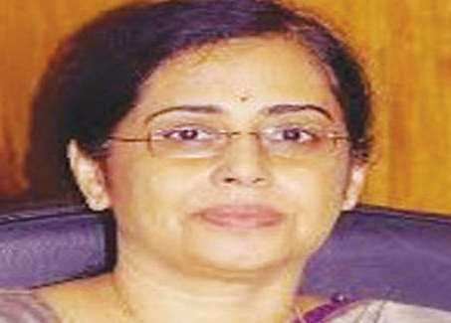
PROMINENT CHARTERED ACCOUNTANTS
CA. Piyush Goyal
Union Cabinet Minister, Government of India.
CA. Suresh Prabhu
Former Union Cabinet Minister, Government of India.
CA. Kumar Mangalam Birla
An Indian billionaire industrialist and the Chairman of the Aditya Birla Group, one of the largest conglomerates in India

Slide 14
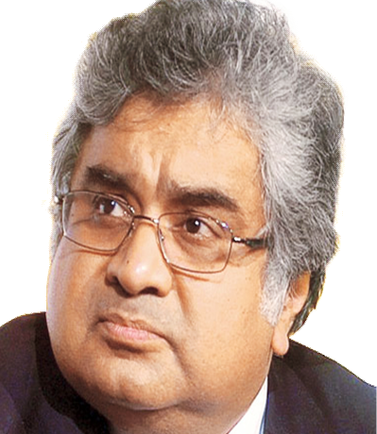
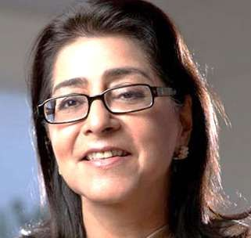
PROMINENT CHARTERED ACCOUNTANTS
Padma Bhushan CA. Harish Salve
Former Solicitor General of India
Senior Advocate in Supreme Court.
CA. Sudha Balakrishnan
12th Executive Director of RBI
First ever Chief Financial Officer chosen by the RBI.
Padma Shri CA. Naina Lal Kidwai
Ex-Country Head of HSBC India.
Chairman of Max Financial Services Ltd.

Slide 15
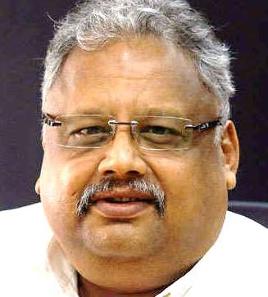
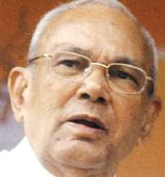
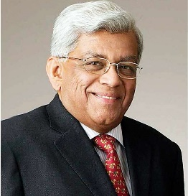
PROMINENT CHARTERED ACCOUNTANTS
CA. Rakesh Jhunjhunwala
An Indian Billionaire Investor and Trader. He is commonly referred as the ‘Warren Buffet of India’
CA. Rameshwar Thakur
Former Indian Union Minister, Governor of Madhya Pradesh, Odisha, Andhra Pradesh and Karnataka.
Served as the president of ICAI from 1966 to 1967.
Padma Bhushan CA. Deepak Parekh
Chairman of HDFC
Non-executive Chairman of IDFC.

Slide 16
WHY IS CA HELD IN HIGH ESTEEM?

Slide 17
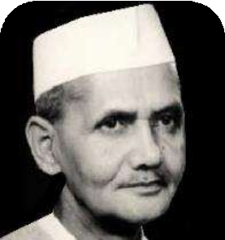
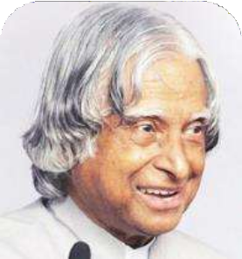
QUOTES FROM SOME DISTINGUISHED LEADERS
Shri Lal Bahadur Shastri
Prime Minister of India 1964-66
Dr. APJ Abdul Kalam
President of India 2002 - 2007
“I cannot conceive what would happen if there were no accountants and no auditors. Not only the mute shareholders in a private company but the industries and the economy of the country as a whole would suffer without your help and adequate guidance.”
“I suggest that all the CAs… should take the following oath… I will not only bring out the problems of Financial Management for protecting the interests of the stakeholders of the enterprises, but also suggest possible solution with ethics as a way of life.”

Slide 18
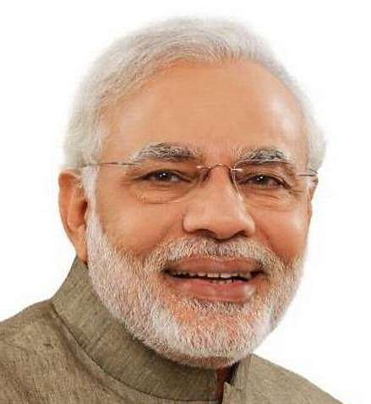
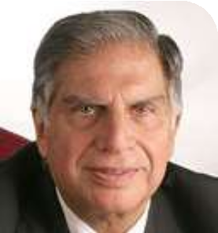
QUOTES FROM SOME DISTINGUISHED LEADERS
Ratan Tata
Chairman Emeritus Tata Group
Shri Narendra Modi
Prime Minister of India
“Yours is a profession in the society that has the capacity to save this entire economy and keep it growing… A Chartered Accountant’s role should be such that he knows that he is not working just to add and subtract these numbers between 0 to 9, but he should feel that he is playing an important role in building the economic infrastructure of this nation.”
“I need MBAs to run my business but I need CAs to teach MBAs how to run the business.”

Slide 19
SOME MOTIVATIONAL CA’s
CA. Prema Jayakumar (CA Final 1st Ranker, Nov’ 2012)
Prema was from very humble background. Her father Jayakumar Perumal is from Tamil Nadu and was an auto driver for 20 years. Her mother used to work for a private company which she stopped later when Prema grew up and started earning during articleship.
CA. Rajni Gopal, First Blind Lady Chartered Accountant
It is inspiring to know that Ranjani Gopal became India’s first visually challenged woman to pass CA examination in the year 2002.
CA. Chirag Chauhan
At the age of 21, Chirag suffered a debilitating spinal cord injury in the 2006 Mumbai Bomb Blasts. He lost both his legs in the incident.
An Auto Rikshaw Driver’s Daughter
First Blind Lady becoming CA
Bomb blast survivor becoming CA

Slide 20
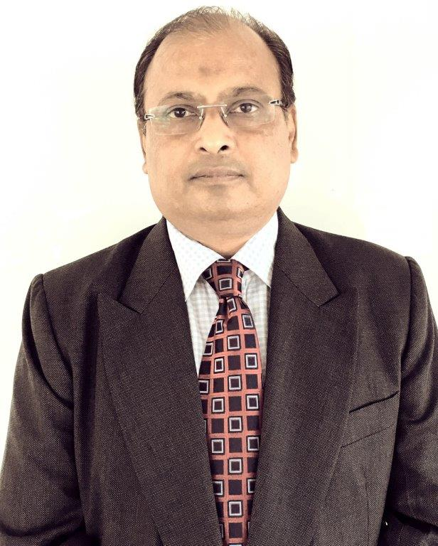
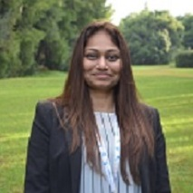
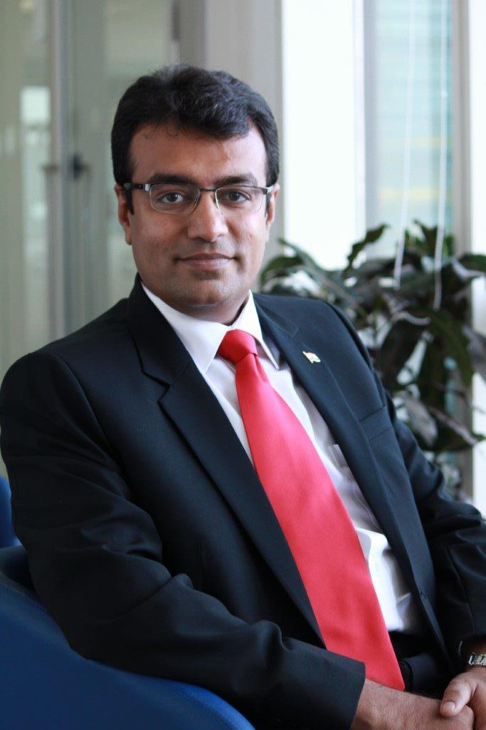
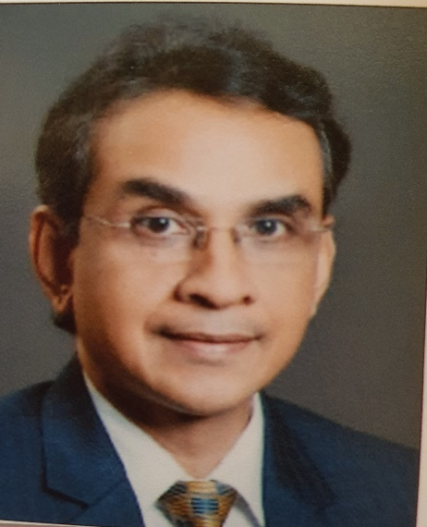
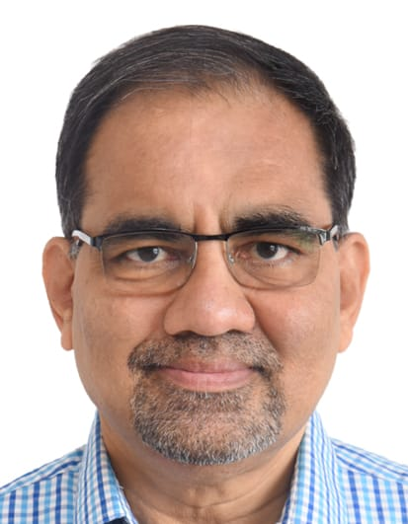
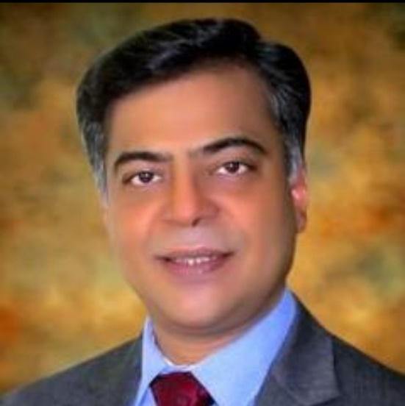
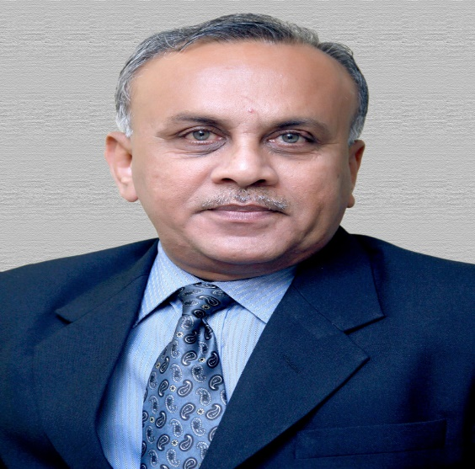
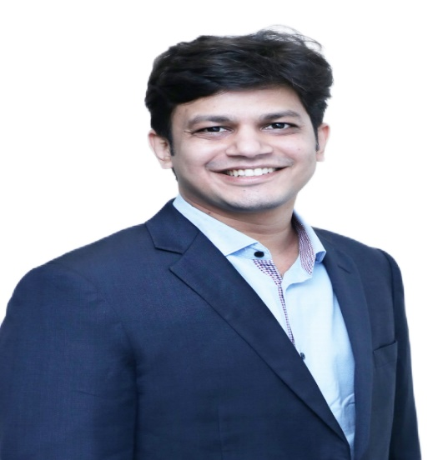
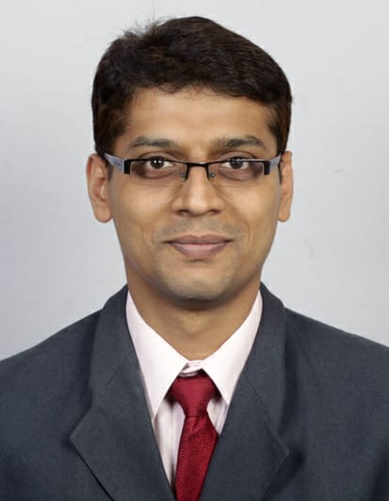
CVOCA MEMBERS SUCCESS STORY
https://www.cvoca.org/newsview.html

Slide 21
ICAI’s INITIATIVES

Slide 22
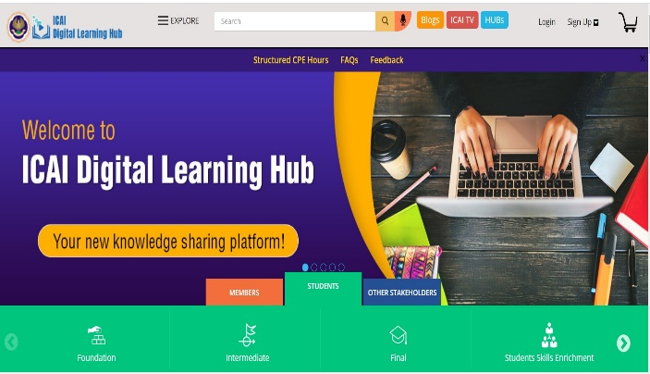
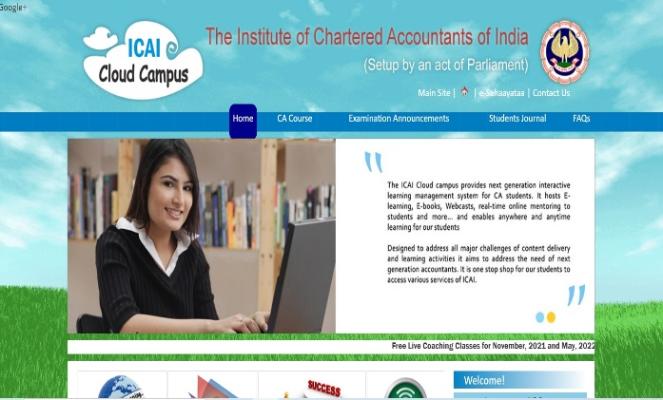
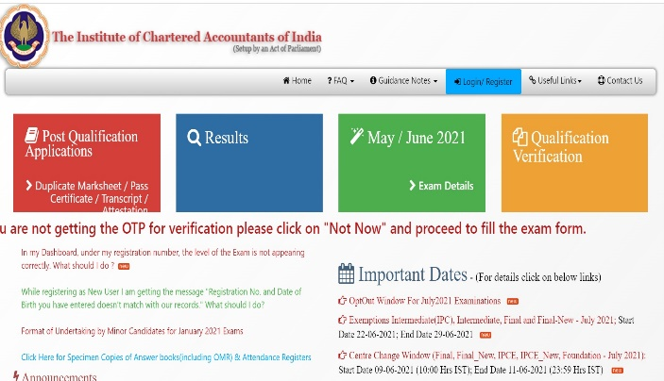
ICAI’s Virtual Classes, e-Learnings and Cloud Campus
https://learning.icai.org/iDH/icai/
https://cloudcampus.icai.org/
https://icaiexam.icai.org/
https://cutt.ly/tmpGroW

Slide 23
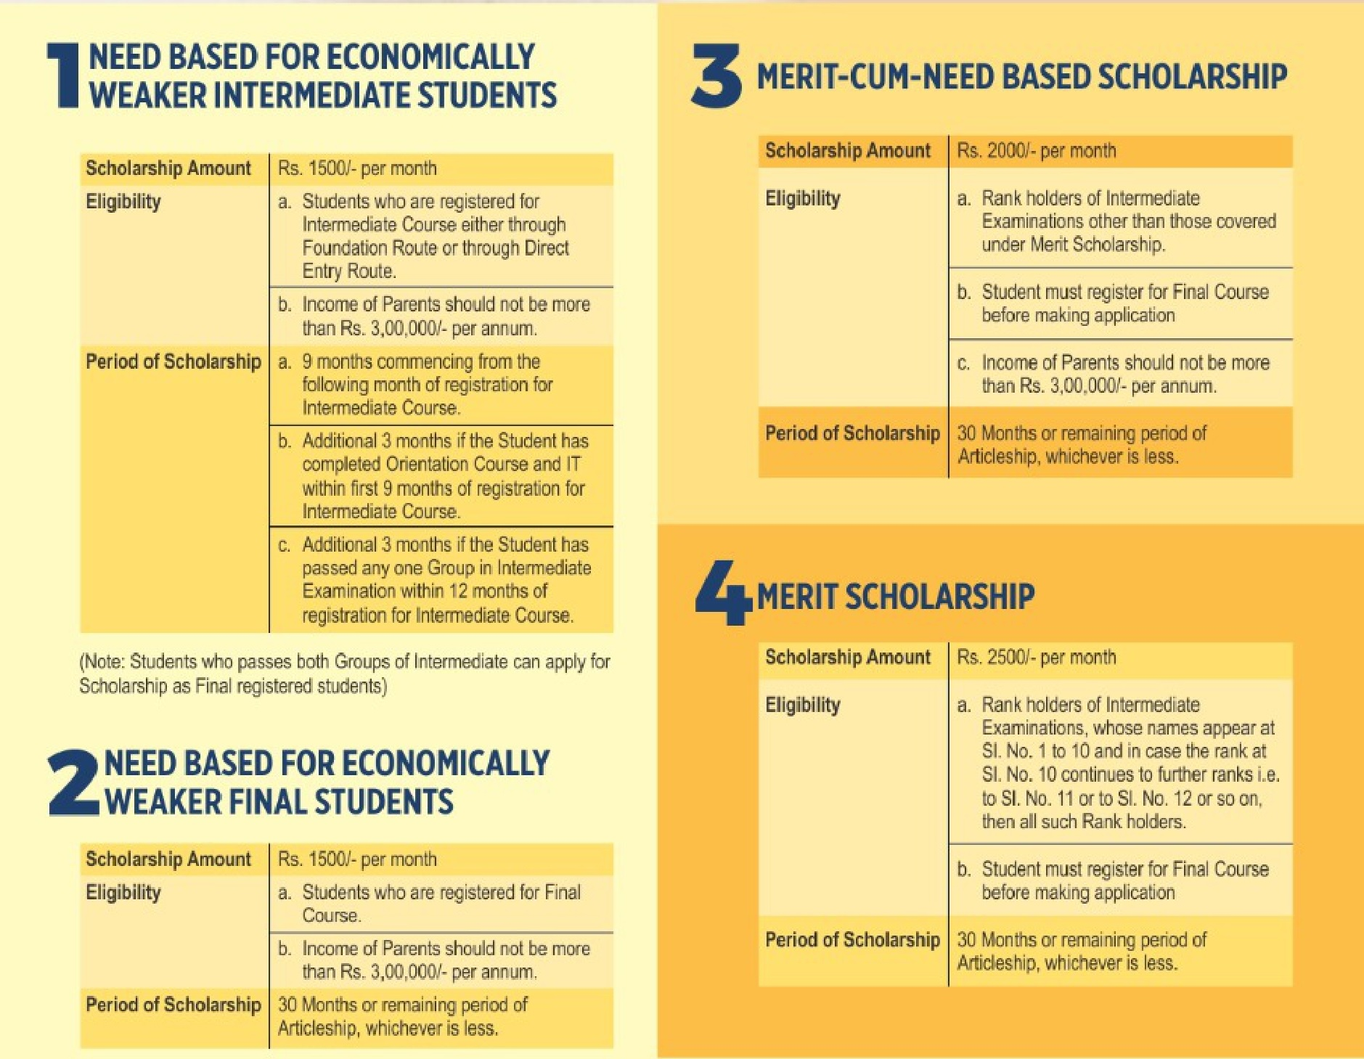
SCHOLARSHIP FOR CA STUDENTS

Slide 24
CA ROADMAP

Slide 25
TIMELINES
ACTIVITY | CURRENT SCHEME | PROPOSED SCHEME
Registration for Foundation / appear for 10+2 | Start | Start
Appear for Foundation Examination | 4 months | 4 months
Study for Intermediate Examination | 8 months | 8 months
Articledship | 36 months | 24 months
Study for Final Examination | - | 6 months
Total period to become ICAI member | 48 months | 42 months
Work experience for applying CoP | - | 12 months

Slide 26
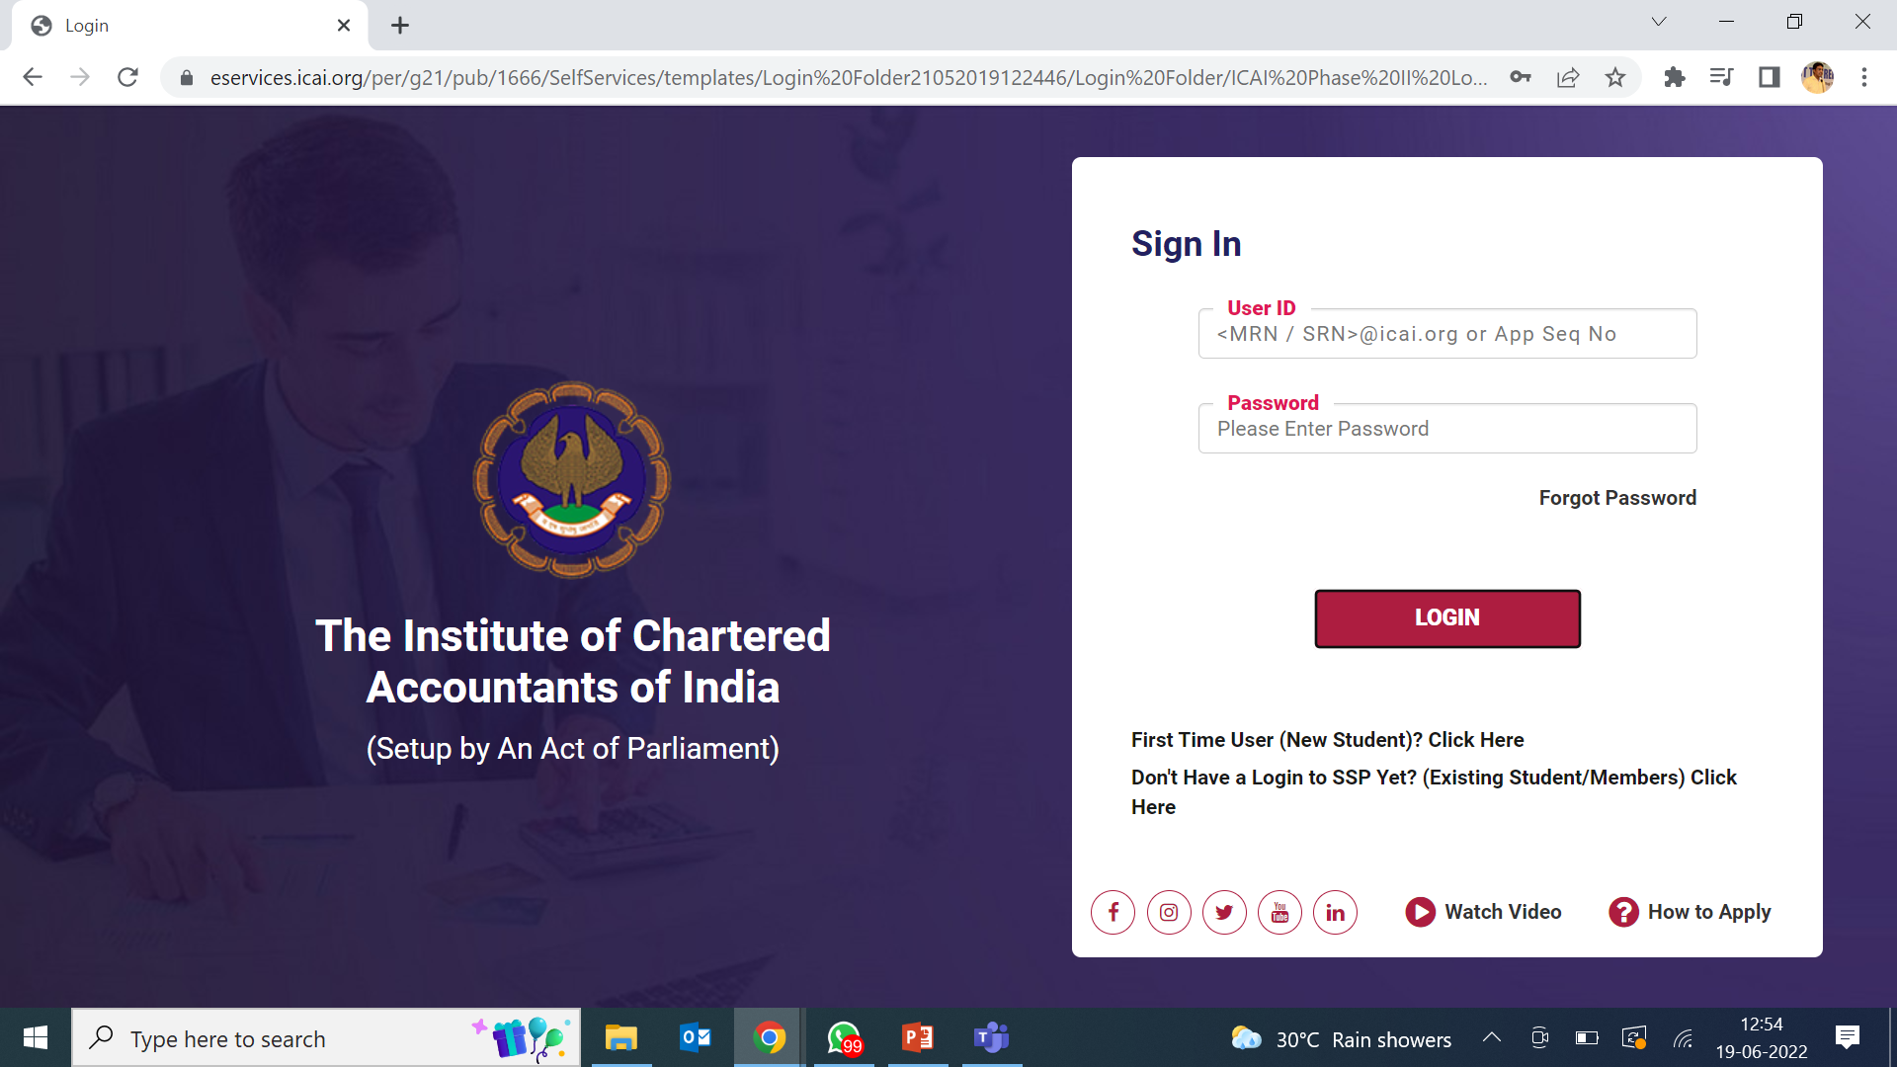
REGISTRATION LINK

Slide 27
EXISTING FEES STRUCTURE

Slide 28
Foundation
Final
Cost of Prospectus 200
Registration Fees 9,000
Final Registration Fees 22,000
Total Fee: 9,200
Total Fee: 22,000
Total Fee: 18,000
Total Fee: 28,000
Intermidiate
Others
Registration Fees 15,000
Students’ Activities Fees 2,000
Registration fees as Article 1,000
IT Course 6,500
Orientation Course 7,000
Advanced IT Course 7,500
Mgmt & Comm Skill Course 7,000
Total Course Fees
₹77,200

Slide 29
STIPEND TO ARTICLE ASSISTANTS
Minimum Stipend to Article Assistants (Institute Recommendation)
Sr. No. | Classification of the normal place of service of the articled assistants | Stipend payable per month (₹) during training |  |  | Total Stipend for Three Years
 |  | 1st year | 2nd year | 3rd year
1 | Cities/ Towns having population of 20 lakh and above
 | Existing | 2,000 | 2,500 | 3,000 | 90,000
 | Proposed | 4,000 | 5,000 | 6,000 | 1,80,000
2 | Cities/ Towns having population of 4 lakh and above but less than 20 lakh
 | Existing | 1,500 | 2,000 | 2,500 | 72,000
 | Proposed | 3,000 | 4,000 | 5,000 | 1,44,000
3 | Cities/ Towns having population of less than 4 lakh
 | Existing | 1,000 | 1500 | 2,000 | 54,000
 | Proposed | 2,000 | 3,000 | 4,000 | 1,08,000
Average Stipend paid in Mumbai by CA Firms:
1st Year: Rs. 5,000
2nd year: Rs. 6,000
3rd Year: Rs 7,000
Total fees for the CA course is Rs. 77,200 whereas minimum stipend paid is Rs. 90,000 for three years in Cities having population of 20 Lacs and above

Slide 30
WHAT HELP CVOCA GIVES?

Slide 31
FINANCIAL ASSISTANCE BY CVOCA
For the benefit of KVO needy students pursuing CA/ CS/ ICWA courses, CVO CA Association has established earmarked fund under the name of 'Shri Shantilal Vershi Haria Educational Assistance Fund'
Following is the list of Coaching Classes and discounts given by them:
Sr. No. | Coaching Classes | Discount
1 | J.K. Shah Classes | 33%
2 | Pinnacle Classes (Dadar) | 33%
3 | AJ Education Next (Andheri)(upto) | 20%
4 | Kirtida Tutorials (Vashi) | 33%
5 | Siddhi Professionals (Mulund) | 33%
6 | Prism Classes (Borivali / Kandivali) | 33%
Discount | Loan | Self
33% | 33% | 33%

Slide 32
OTHER SUPPORT BY CVOCA
Publishing articleship vacancy of CVOCA firms in Kutchi Patrika
Conducting orientation course for fresh article assistants
Interest free Laptop loans for needy students
Conducting Career guidance / Mentorship Programme
Conducting various seminars on professional topics for CA students

Slide 33
Thank You

